Slide 1
Highways and words: Does isolation predict cultural homogeneity and distinctiveness?
Anjali Bhatt & Molly Lewis
June 30th, 2017
Summer Institute in Computational Social Science

Slide 2
Motivation
Methods
Findings
Next Steps

Slide 3
Cultural diversity matters

Slide 4
Language is a window into culture

Slide 5

What explains within-language variation?
“Code-switching”

Slide 6
Can highways be cultural connectors?
Hypothesis 1: Towns further away from highways are more linguistically homogenous
Hypothesis 2: Towns further away from highways are more linguistically distinctive from each other

Slide 7
Motivation
Methods
Findings
Next Steps

Slide 8
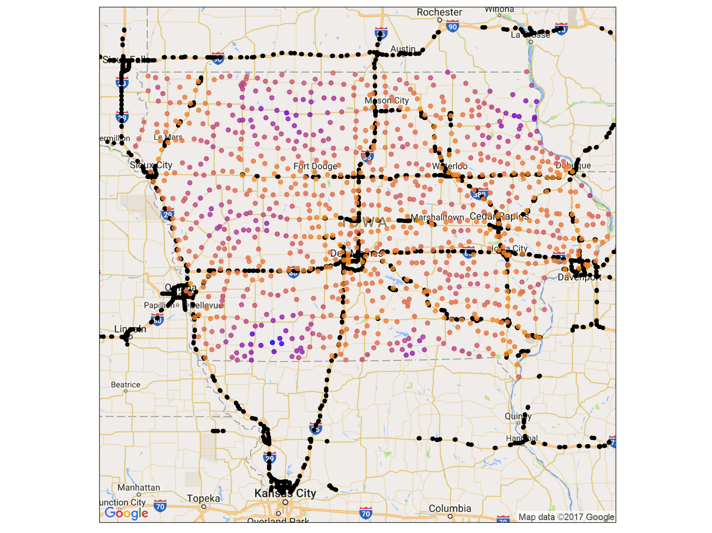
Iowa as a pilot study
Highway exits from OpenStreetMap (includes nearby exits outside of Iowa)
946 incorporated cities in Iowa, excluding Des Moines
Driving time to highway ranges from 2 to 83 min (median of 20 min)
NEED PLOT LEGEND

Slide 9
Text from Google place reviews
Fetch all reviews for establishments within a 5km radius of city centers
24,469 total reviews
Retain 546 cities with at least 5 reviews
REDO PLOT

Slide 10
Motivation
Methods
Findings
Next Steps

Slide 11
Linguistic Features
Review length
Capitalization
Emoji use
Punctuation
Sentiment

Slide 12
Linguistic Diversity
xxx

Slide 13
Linguistic Distinctiveness
xxx

Slide 14
Motivation
Methods
Findings
Next Steps

Slide 15
Appendix

Slide 16
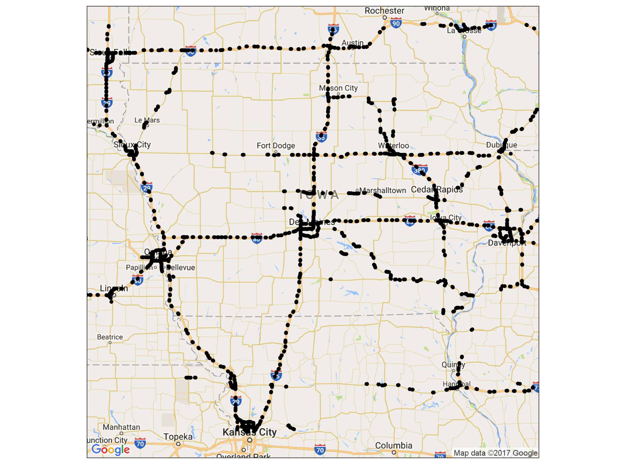
Highway Exits

Slide 17
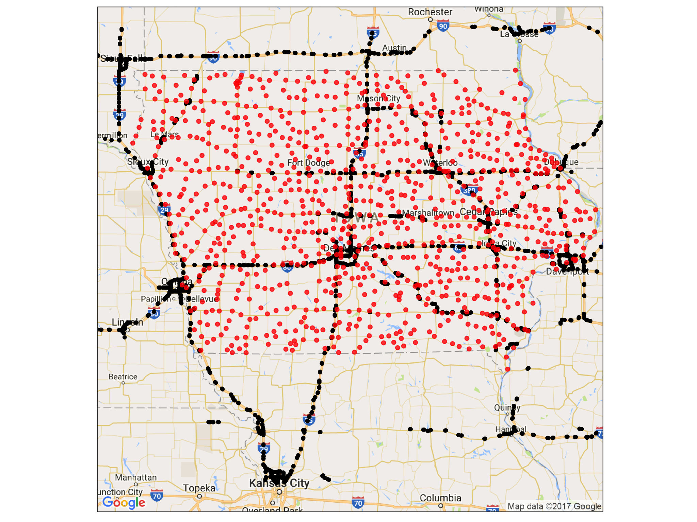
Towns in Iowa

